Slide 1
Subneting CS F303
Dr. Pranav M. Pawar

Slide 2
Problem Statements
Design a subnet for IP address 192.168.10.0/25

Slide 3
Subnetting Example (1)
Given IP Address: 192.168.10.0 / 25 (Class C)
Subnet mask should consist of 25 1’s as IP address is with /25.
Subnet Mask:
11111111.11111111.11111111.10000000
255.255.255.128
No of Subnets:
No of subnets are depends on number of extra 1s in default subnet mask.
In current example,
No of extra 1s in subnet mask than default mask: 1
Therefore, no of subnets = 2¹ = 2 subnets
No of host per subnets:
No of host per subjects depends on number of 0s in subnet mask.
In current example,
No of 0s in subnet mask = 7
Therefore, no of host per subnets = 2⁷ = 128

Slide 4
Subnetting Example (1)
Valid subnets blocks are,
192.168.10.0 to 192.168.10.127
192.168.10.128 to 192.168.10.255
Valid host addresses in each subnets are,
Subnet1:
First host address: 192.168.10.1
Last host address: 192.168.10.126
Subnet 2:
First host address: 192.168.10.129
Last host address: 192.168.10.254
Other addresses in each subnet
Subnet 1:
Subnet (Network) address: 192.168.10.0
Broadcast address: 192.168.10.127
Subnet 2:
Subnet (Network) address: 192.168.10.128
Broadcast address: 192.168.10.255

Slide 5
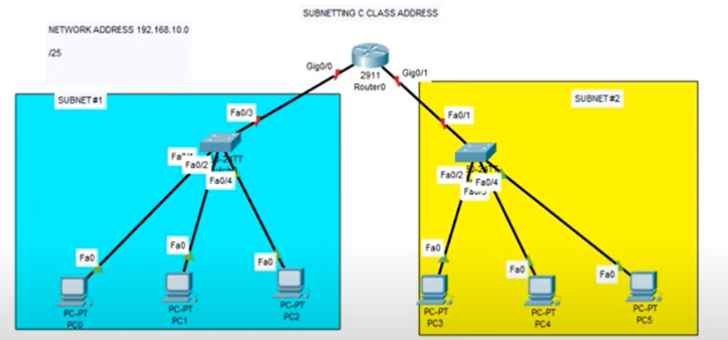
Subnetting Scenario

Slide 6
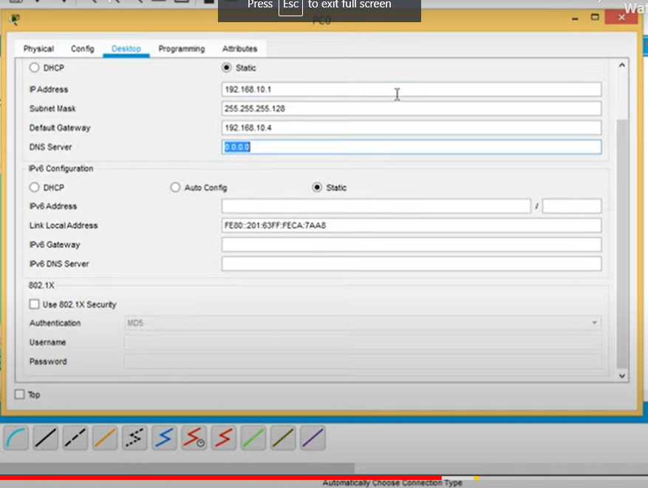
Set the IP address for host and gateway

Slide 7
Practice Scenario
Design a subnet for network with IP address 193.175.12.0/26.

Slide 8
Thank You!

